Slide 1
WAY-VISTA — SMART JOURNEY PREDICTOR
Travel Time Prediction Using Ridge & Lasso Regression
An intelligent transit analytics engine combining spatial routing, real-time meteorological indicators, and regularized regression models.
PRESENTED BY
Ch. Shanthi Swaroop Roll No: 2520090224
M. Abhi Sai Sagar Roll No: 2520090173
P. Goutham Vikas Roll No: 2520090096
PROJECT GUIDE
Mrs. I V S L Haritha
Department of Computer Science & Information Technology
Associate Professor, Dept. of CS&IT
KL University – Bachupally

Slide 2


PROJECT OVERVIEW
Introduction & Domain Background
Intelligent Transit Domain
Multi-Factor Complexity
The WayVista Solution
Urban transit management depends heavily on accurate Estimated Time of Arrival (ETA) predictions.
Travel time fluctuates dynamically with precipitation, temperature variations, and peak congestion levels.
A lightweight ML architecture predicting exact ETA durations using Ridge and Lasso feature shrinkage.

Slide 3
Problem Statement
Static Speed Assumptions
Multicollinear Noise
Downstream Impact
Standard routing services rely on speed limits without modeling weather impact or peak hour bottlenecks.
Standard linear models overfit correlated inputs such as road distance, speed profiles, and durations.
Inaccurate ETAs cause delayed freight delivery schedules, driver fatigue, and commuter frustration.

Slide 4



Project Motivation
Real-World Logistics Demand
Supply chain companies require accurate journey ETAs to schedule dispatch windows and warehouse labor.
Interpretability vs Black-Box Neural Nets
Regularized linear estimators provide transparent feature weights and sub-millisecond inference speeds.
Lightweight Production Feasibility
Deployable on low-cost edge servers without requiring expensive GPU infrastructure or complex pipelines.

Slide 5
Project Objectives
01
Develop a unified ETL pipeline querying OpenStreetMap, OSRM routes, and Open-Meteo weather data.
02
Train and hyperparameter-tune regularized Ridge (L2) and Lasso (L1) regression models using 5-fold CV.
03
Implement out-of-distribution guards alerting users when trip distances exceed the 50 km training threshold.
04
Deploy a responsive FastAPI application with live Leaflet route mapping and side-by-side OSRM benchmark.

Slide 6
Existing System & Drawbacks
Standard Routing Tools
Operational Deficiencies
•
Static Speed Graphs: Compute transit time strictly via posted road speed averages.
•
High Error Spikes: ETAs deviate by 20% to 45% during rain storms.
•
Single Heuristic: Pure shortest-path Dijkstra algorithms ignoring weather severity.
•
Rigid Assumptions: Incapable of continuous tuning to historical driver datasets.
•
Deterministic ETA: Fails to adapt to temporal variations like morning peak hours.
•
No Confidence Range: Lacks out-of-distribution alerts when queries leave typical zones.

Slide 7
Proposed System: VoyageML
Dynamic Feature Blending
Dual Regularized Engines
Safeguarded Inference
Integrates physical road distance with live precipitation, ambient temperature, and congestion indices.
Deploys L2 Ridge to handle collinearity and L1 Lasso to eliminate 4 zero-impact redundant features.
Evaluates trip boundaries and issues clear OOD warnings whenever input paths exceed 2000 km training data.

Slide 8
System Architecture
TIER 1: CLIENT LAYER
TIER 2: BACKEND API
TIER 3: SERVICE INGESTION
TIER 4: ML CORE
Interactive Web UI
FastAPI Application
Geo & Weather Engine
Inference Pipeline
HTML5, CSS3, Vanilla JS, Leaflet.js Map Viewer
Uvicorn, Pydantic Schema Validation, Error Interceptor
OSRM Waypoints, Nominatim Geocoder, Open-Meteo
Ridge / Lasso PKL Models, Decision Tree & Scalers
Data Pipeline Rule: Automatic fallback to pre-cached coordinates and Haversine distance if external APIs timeout.

Slide 9
End-to-End Methodology
1
2
3
4
5
User Query
Geocoding
Environment Ingestion
Model Inference
ETA & Map Display
Source, destination, & scheduled departure time entered.
Coordinates extracted; OSRM queries road geometry.
Real-time weather, temperature, and rain levels extracted.
Lasso and Ridge estimators predict duration in minutes.
Arrival timestamp, Leaflet waypoints, and OSRM delta rendered.

Slide 10


Technology Stack
Python & ML Stack
Backend Server
Geospatial APIs
Frontend & UI
Python 3.10+, Scikit-Learn 1.4, Pandas 2.2, NumPy 1.26
FastAPI 0.110, Uvicorn ASGI, Pydantic, Python-Dotenv
OSRM Routing Engine, Open-Meteo, OpenStreetMap
HTML5, CSS3, JavaScript ES6, Leaflet.js Mapping

Slide 11



System Modules
Trip Planner Module
Live Data Harvester
Predictive Core
Map & Telemetry UI
Origin-destination input validation, departure picker, and traffic density override switches.
Fetches waypoint coordinates, road distance, elevation, and hourly weather parameters.
Applies learned Ridge and Lasso coefficients to produce calibrated duration predictions.
Renders interactive Leaflet polylines alongside API duration and OOD limitation alerts.

Slide 12
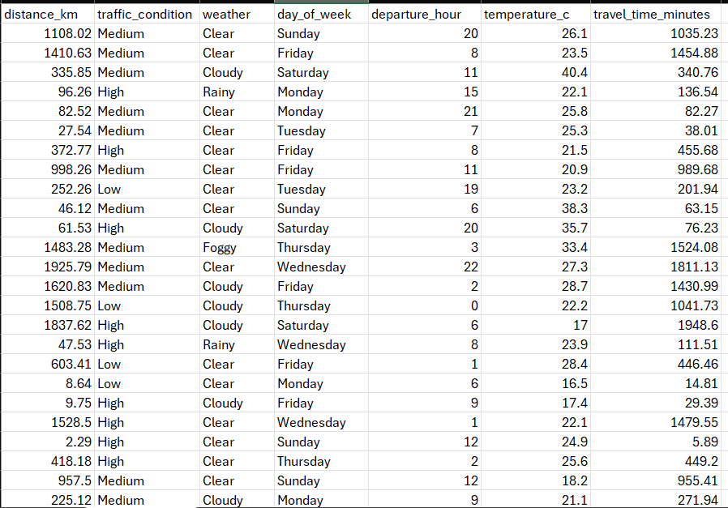
Dataset & Feature Schema

Slide 13
Regularization Algorithms
L2 REGULARIZATION
L1 REGULARIZATION
Ridge Regression
Lasso Regression
Adds squared magnitude penalty (λ||w||₂²) to stabilize weights amidst correlated variables.
Applies absolute weight penalty (λ||w||₁) enforcing true feature sparsity.
Loss = MSE + α * Σ(wᵢ²)
Loss = MSE + α * Σ|wᵢ|
Optimal α: 2.1544 tuned via 5-Fold Cross Validation.
Optimal α: 0.0187 — zeroes out 4 non-informative indicators.

Slide 14
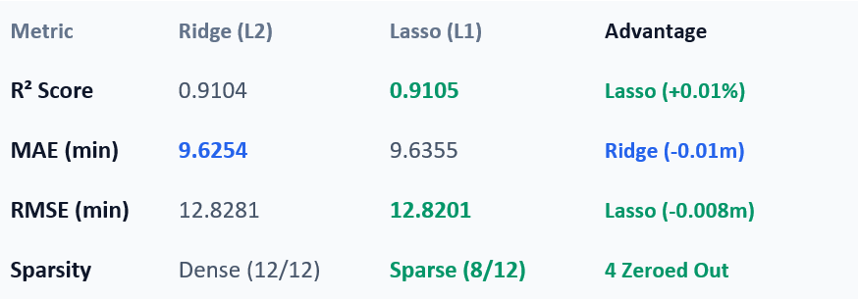
Results & Comparision
LASSO R² VARIANCE
RIDGE R² VARIANCE
RIDGE MIN MAE
LASSO MIN RMSE
91.05%
91.04%
9.63 min
12.82 min
Comparative Test Metrics
Continuous travel time regression requires R², MAE, and RMSE benchmarks rather than classification metrics like Accuracy or F1-Score.
Standard navigation algorithms ignore weather dampening and temporal peaks; WayVista combines real-time weather and OSRM geometry.
Lasso delivers identical predictive variance with a simpler, zero-baggage feature representation.
Operational Range: 1 – 2000 km training threshold.

Slide 15
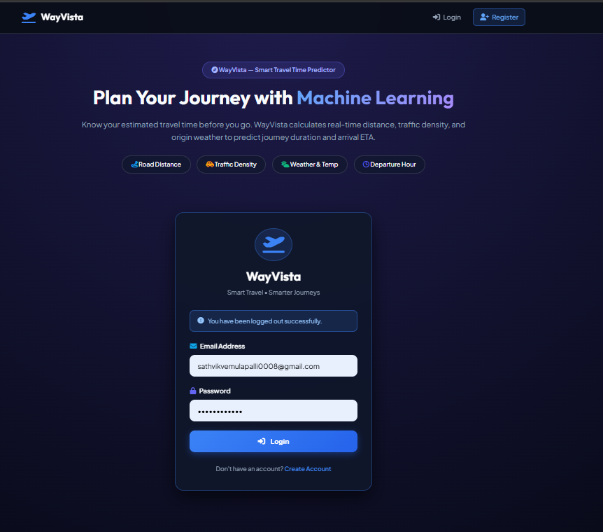

Screenshots

Slide 16
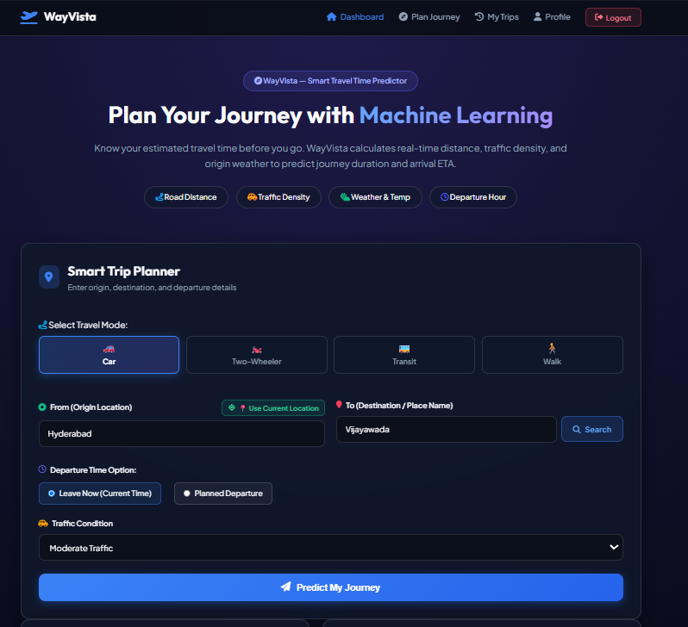
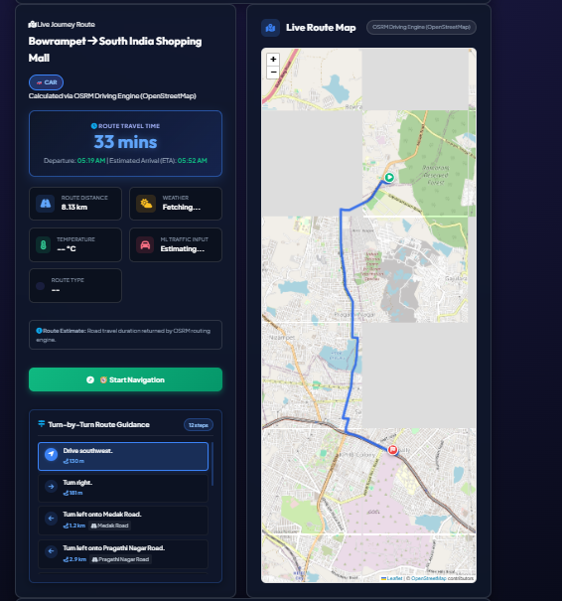

Slide 17
Advantages & Real-World Use
System Advantages
Target Applications
•
Sub-Millisecond Inference: Operates without heavy GPU requirements.
•
Freight Logistics: Dynamic dispatch for interstate haulers.
•
Weather-Aware Accuracy: Incorporates rain & fog speed dampening.
•
On-Demand Deliveries: Accurate food & parcel delivery time windows.
•
Transparent Coefficients: Avoids black-box deep learning unreliability.
•
Emergency Dispatch: Weather-calibrated routing for ambulances.

Slide 18
Limitations & Future Scope
Current Limitations
Future Scope
•
Linear Extrapolation Range: Accuracy diminishes above 50 km boundary.
•
Deep Learning Ensembles: Incorporate LSTM networks for sequential routes.
•
Synthesized Traffic Data: Relies on user override or static indices.
•
Live GPS Telemetry: Ingest fleet IoT feeds via Kafka streams.
•
Weather Latency: Free weather APIs refresh on an hourly schedule.
•
Distributed Training: Automated continuous model retraining pipelines.

Slide 19
Conclusion & Key Outcomes
Successfully developed and validated a full-stack ML travel time predictor that fuses geospatial routing, weather parameters, and regularized regression.
0.9105
9.63m
<50ms
TEST R² SCORE
MEAN ABSOLUTE ERROR
INFERENCE LATENCY
Thank You!

